Slide 1

Session 2

Slide 2

Agenda
Session 2
Quiz
Homework discussion
Filtering and Sorting data
Workshop
Combining sets (UNION, UNION ALL, INTERSECT)
Workshop
Table constraints (Default, Check, Unique)
Workshop
Referential integrity (Foreign Keys)
Workshop
Join Types (Left, Right, Inner, Cross Join)
Workshop
Knowledge check (Discussion, Homework)

Slide 3
Quiz

Slide 4
Homework discussion

Slide 5
Fill database with example data
Let’s populate the tables with example data
Execute script: Session 2 – 01 Insert example data in SEDC database.sql
NOTE: Do not go into details with this script – JUST RUN IT

Slide 6
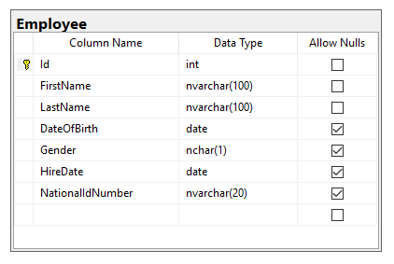
Filtering data
Filtering expressions are used to reduce number of rows returned based on some criteria
WHERE statement
Example:
SELECT *
FROM TableName
WHERE ColumnName = value
SELECT *
FROM Employee
WHERE FirstName = 'Aleksandar'

Slide 7
Filtering data - Workshop
Find all Employees with FirstName = Goran
Find all Employees with LastName starting With ‘S’
Find all Employees with DateOfBirth greater than ‘01.01.1980’
Find all Male employees
Find all employees hired in June/2010
Find all Employees with LastName starting With ‘M’ hired in January/2010

Slide 8
Sorting data
Ordering the results based on specific order
ORDER BY statement
Example:
SELECT *
FROM TableName
ORDER BY ColumnName ASC\DESC
SELECT *
FROM Employee
ORDER BY FirstName ASC

Slide 9
Sorting data - Workshop
Find all Employees with FirstName = Aleksandar ordered by Last Name
List all Employees ordered by FirstName
Find all Male employees ordered by HireDate, starting from the last hired

Slide 10
Combining sets
Union, Union ALL, Intersect

Slide 11
Combining sets - UNION
UNION set operator unifies the results of the two input queries. As a set operator, UNION has an implied DISTINCT property, meaning that it does not return duplicate rows.
Duplicates are eliminated
Pre-requisites
All sets should have same number and order of columns
Columns should be of same or compatible data type
Example:
Set1
Set2
SELECT Region
FROM BusinessEntity
UNION
SELECT RegionName
FROM Customer

Slide 12
Combining sets – UNION ALL
UNION ALL operator unifies the results of the two input queries. As a set operator, UNION ALL doesn’t have an implied DISTINCT property, meaning that it can return duplicate rows.
Duplicates remain
Pre-requisites
All sets should have same number of columns
Columns should be of same or compatible data type
Example:
Set1
Set2
SELECT Region
FROM BusinessEntity
UNION ALL
SELECT RegionName
FROM Customer

Slide 13
Combining sets – INTERSECT
INTERSECT operator returns only distinct rows that are common to both sets. In other words, if a row appears at least once in the first set and at least once in the second set, it will appear once in the result of the INTERSECT operator.
Pre-requisites
All sets should have same number of columns
Columns should be of same or compatible data type
Example:
Set1
Set2
SELECT FirstName, LastName
FROM Employee
WHERE FirstName = 'Aleksandar'
INTERSECT
SELECT FirstName, LastName
FROM Employee
WHERE LastName = 'Nikolovski'

Slide 14
Combining sets - Workshop
List all BusinessEntity Names and Customer Names in single result set with duplicates
List all regions where some BusinessEntity is based, or some Customer is based. Remove duplicates
List all regions where we have BusinessEntities and Customers in the same time

Slide 15
Table constraints
NOT NULL, UNIQUE, CHECK PRIMARY KEY, FOREIGN KEY

Slide 16
Table constraints – Not Null
By default, a column can hold NULL values. If you do not want a column to have a NULL value, then you need to define such constraint on this column specifying that NULL is now not allowed for that column. A NOT NULL constraint is always written as a column constraint.
Example:
CREATE TABLE Customer (
Name TEXT NOT NULL,
Address TEXT NULL);

Slide 17
Table constraints – Unique
The UNIQUE Constraint prevents two records from having identical values in a particular column.
Example:
CREATE TABLE Customer (
Name TEXT,
Address TEXT,
PhoneNumber Text UNIQUE);

Slide 18
Table constraints - Check
The CHECK Constraint enables a condition to check the value being entered into a record. If the condition evaluates to false, the record violates the constraint and is not entered into the table.
Example:
CREATE TABLE Customer (
Name TEXT,
Address TEXT,
Age INTEGER CHECK(Age > 18));

Slide 19
Table constraints – Primary Key
The PRIMARY KEY constraint uniquely identifies each record in a database table. There can be more UNIQUE columns, but only one primary key in a table. Primary keys are important when designing the database tables. Primary keys are unique ids.
We use them to refer to table rows. Primary keys become foreign keys in other tables, when creating relations among tables. Due to a 'longstanding coding oversight', primary keys can be NULL in SQLite. This is not the case with other databases.
A primary key is a field in a table, which uniquely identifies each row/record in a database table. Primary keys must contain unique values. A primary key column cannot have NULL values.
A table can have only one primary key, which may consist of single or multiple fields. When multiple fields are used as a primary key, they are called a composite key.
If a table has a primary key defined on any field(s), then you cannot have two records having the same value of that field(s).
CREATE TABLE Customer (
Id INTEGER PRIMARY KEY,
Name TEXT,
Address TEXT);

Slide 20
Table constraints – Foreign Key
A foreign key constraint specifies that the values in a column (or a group of columns) must match the values appearing in some row of another table. We say this maintains the referential integrity between two related tables. They are called foreign keys because the constraints are foreign; that is, outside the table. Foreign keys are sometimes called a referencing key.
Example:
CREATE TABLE Employee (
Name TEXT,
Address TEXT,
Age INTEGER,
CompanyId INTEGER references Company(CompanyId));
CREATE TABLE Company (
CompanyId INTEGER PRIMARY KEY,
Name TEXT,
Address TEXT);

Slide 21
Table constraints - Workshop
Create Products table that prevents inserting a Price that is twice smaller than Cost
Create Products table to guarantee unique names across the products
Add foreign key between tables BusinessEntity, Customer, Employee, and Order with scripts

Slide 22
Types of relations
Types of relations between tables
One-to-Many Relationship (1:M) – Most common
A one-to-many relationship is the most common type of relationship. In this type of relationship, a row in table A can have many matching rows in table B, but a row in table B can have only one matching row in table A. For example, one Customer can have many Orders, but one order is only for 1 Customer.
Many-to-Many Relationships (M:M)
In a many-to-many relationship, a row in table A can have many matching rows in table B, and vice versa. You create such a relationship by defining a third table - C, called a junction table, whose primary key consists of the foreign keys from both tables A and table B.
For example the BusinessEntity table and the Customer table both have 1:M relation with Orders table which makes the M:M relation.
One-to-One Relationships (1:1)
In a one-to-one relationship, a row in table A can have no more than one matching row in table B, and vice versa. Example is the Customer table we have PhoneNumber column which can be placed in different table - CustomerPhone.
Relations are also known as Foreign Key (FK) relations.

Slide 23
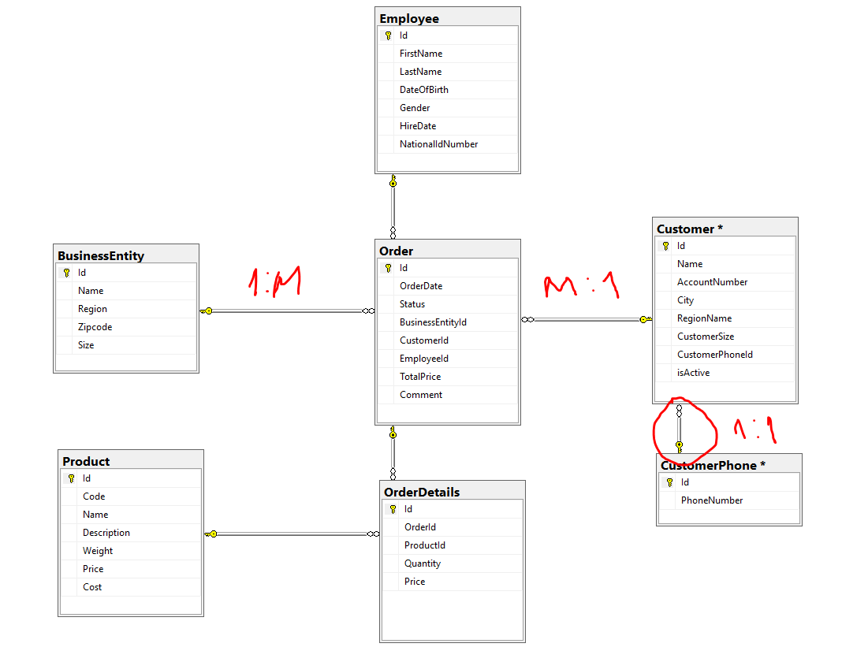
Types of relations – Explained

Slide 24
Join types
Inner, Outer, Left, Right, Cross

Slide 25
Join types
Often, data that you need to query is spread across multiple tables. The more normalized the environment is, the more tables you usually have.
The tables are usually related through keys, such as a foreign key in one side and a primary key in the other. Then you can use joins to query the data from the different tables and match the rows that need to be related.
The different types of joins that T-SQL supports:
Cross
Inner
Outer

Slide 26
Join types – Cross join
A CROSS JOIN matches every row of the first table with every row of the second table. If the input tables have x and y columns, respectively, the resulting table will have x+y columns. Because CROSS JOINs have the potential to generate extremely large tables, care must be taken to use them only when appropriate.
SELECT * FROM Table1 CROSS JOIN Table2

Slide 27
Join types – Inner join
A INNER JOIN creates a new result table by combining column values of two tables (table1 and table2) based upon the join-predicate. The query compares each row of table1 with each row of table2 to find all pairs of rows, which satisfy the join-predicate. When the join-predicate is satisfied, column values for each matched pair of rows of table1 and table2 are combined into a result row.
An INNER JOIN is the most common type of join and is the default type of join. You can use INNER keyword optionally.

Slide 28
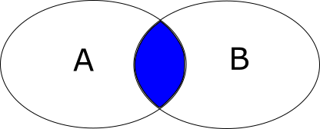
Join types – Inner join example
SELECT table1.column1, table2.column2 ...
FROM table1
INNER JOIN table2
ON table1.commonField = table2.commonField;

Slide 29
Join types – Outer join
The OUTER JOIN is an extension of the INNER JOIN. SQL standard defines three types of OUTER JOINs: LEFT, RIGHT, and FULL and PostgreSQL supports all of these.

Slide 30
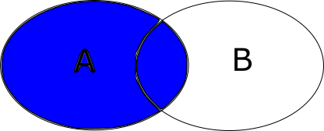
Join types – Left Outer Join
In case of LEFT OUTER JOIN, an inner join is performed first. Then, for each row in table T1 that does not satisfy the join condition with any row in table T2, a joined row is added with null values in columns of T2. Thus, the joined table always has at least one row for each row in T1.
Example:
SELECT ...
FROM table1
LEFT OUTER JOIN table2
ON conditional_expression ...

Slide 31
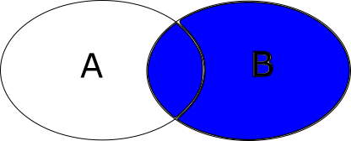
Join types – Right Outer Join
First, an inner join is performed. Then, for each row in table T2 that does not satisfy the join condition with any row in table T1, a joined row is added with null values in columns of T1. This is the converse of a left join; the result table will always have a row for each row in T2.
Example:
SELECT ...
FROM table1
RIGHT OUTER JOIN table2
ON conditional_expression ...

Slide 32

Join types – Full Outer Join
First, an inner join is performed. Then, for each row in table T1 that does not satisfy the join condition with any row in table T2, a joined row is added with null values in columns of T2. In addition, for each row of T2 that does not satisfy the join condition with any row in T1, a joined row with null values in the columns of T1 is added.
Example:
SELECT ...
FROM table1
FULL OUTER JOIN table2
ON conditional_expression ...

Slide 33
Join types - Demo
Create two tables (Table1, Table2)
Insert 3 records in each with values (1, 2, 3), (3, 4, 5)
Show all join types on this example

Slide 34
Join types - Workshop
List all possible combinations of Customer names and Product names that can be ordered from a specific customer
List all Business Entities that have an order
List all Entities without orders
List all Customers without orders (using Right Join and using Left join)

Slide 35
Homework 2

Slide 36
Homework – pre-requisite
A script is provided for inserting dummy data in already created SEDC database

Slide 37
Homework requirement 1/6
Find all Employees with FirstName = Antonio
Find all Employees with DateOfBirth greater than ‘01.01.1979’
Find all Male Employees
Find all Employees with LastName starting With ‘T’
Find all Employees hired in January/1988
Find all Employees with LastName starting With ‘J’ hired in January/1988

Slide 38
Homework requirement 2/6
Find all Employees with FirstName = Antonio ordered by Last Name
List all Employees ordered by FirstName
Find all Male employees ordered by HireDate, starting from the last hired

Slide 39
Homework requirement 3/6
List all Business Entity region and Customer region names in single result set WITH duplicates
List all Business Entity region and Customer region names in single result set WITHOUT duplicates
List all common region names between Business Entities and Customers

Slide 40
Homework requirement 4/6
Provide create table script for the Order table where it won’t allow an orderDate before 01.01.2010
Provide create table script for the Product table where the price will always be AT LEAST 20% higher than the cost
Provide create table script for the Product table where all description values will be UNIQUE

Slide 41
Homework requirement 5/6
Create Foreign key constraints for the Order table with script

Slide 42
Homework requirement 6/6
List all possible combinations of Customer names and Product names that can be ordered from a specific customer
List all Business Entities that has any order
List all Business Entities without orders
List all Customers without orders (using Right Join and using Left join)

Slide 43
QUESTIONS

